Slide 1

Website Funnel Analysis for October 2025
Comprehensive Data Analytics Project: Understanding User Journey and Conversion Performance
DATA ANALYTICS
BUSINESS INTELLIGENCE
Developed By – Rohit Das

Slide 2

01
Introduction
This presentation covers a website funnel analysis conducted for a digital-first electronics brand using website interaction data from October 2025. The purpose of the analysis is to understand how users move through key stages of the website funnel, from initial browsing to final purchase, and to evaluate conversion performance at each stage.
Using 21,663 website session records, the analysis examines user behavior across funnel stages, identifies major drop-off points, and measures key performance indicators such as conversion rates, revenue contribution, bounce rate, and session engagement. The study also reviews funnel performance across different channels, regions, and product categories.
The analysis was performed using Python for exploratory data analysis and Power BI for dashboard visualization, providing a clear and structured view of website performance. The insights from this analysis are intended to support data-driven decision-making and help identify areas for improving user experience and conversion efficiency.

Slide 3
02
Business Problem Statement
The Challenge
Core Business Issues
Understanding how users move through the website funnel and where they drop off is important for improving conversions and revenue. Although the website receives consistent traffic, there is limited clarity on how users behave across key funnel stages, from browsing to purchase.
Conversion drop-offs at key funnel stages are not clearly measured
Limited visibility into session-level user journeys and funnel progression
Difficulty identifying which stages contribute most to lost conversions
Lack of a clear, data-driven view to support optimization decisions
This analysis focuses on identifying funnel performance gaps and providing clear insights to support better conversion and business decisions.

Slide 4

03
Key Business Questions
Funnel Performance
Drop-off Analysis
How many users progress through each funnel stage from Browse to Purchase, and what is the overall conversion rate?
At which funnel stages do users drop off the most, and where are the biggest conversion losses?
Revenue Impact
Optimization Priorities
How much revenue is generated at each funnel stage, and what is the average order value from completed purchases?
Which funnel stages need immediate improvement to increase conversions and overall revenue?

Slide 5

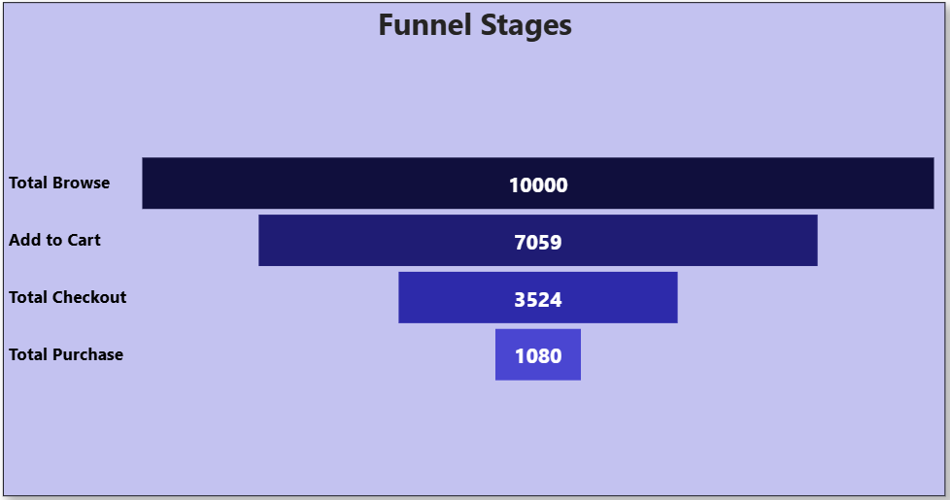
04
Exploratory Data Analysis
Funnel Performance (Session-Level)
Total Sessions Analyzed: 10,000
Overall Conversion Rate: 10.8%
Users reaching Purchase stage: 1,080 sessions
Stage-wise Funnel Movement
Browse → Add to Cart: 70.6% conversion (7,059 users)
Add to Cart → Checkout: 49.9% conversion (3,524 users)
Checkout → Purchase: 30.7% conversion (1,080 users)
Largest drop-off occurs at Checkout → Purchase (69.3%)
Revenue Insights
Total Revenue Generated: $1,176,405.78
Average Order Value (AOV): $1,089.26
Total Completed Orders: 1,080

Slide 6

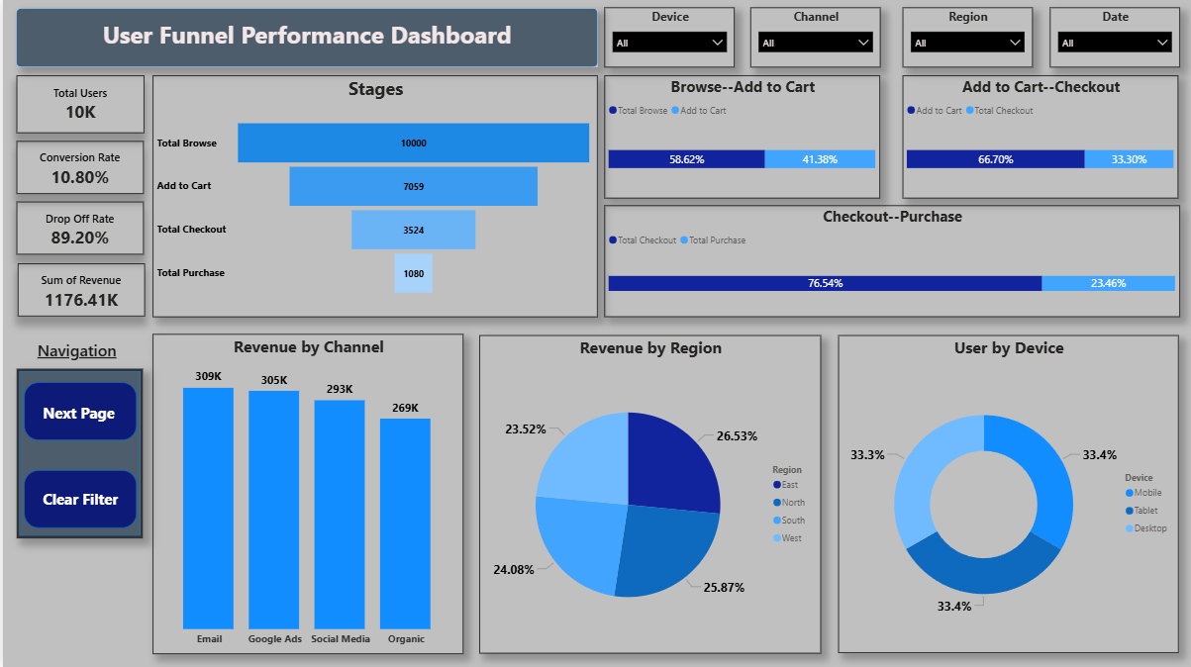
05
User Funnel Performance Dashboard

Slide 7
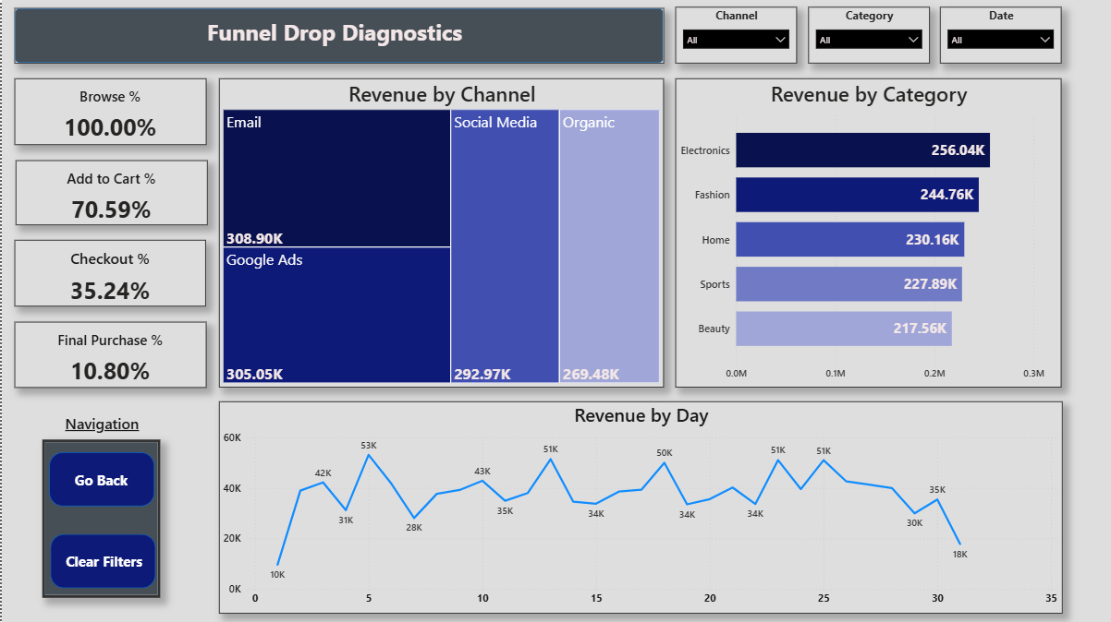
06
Funnel Drop Diagnostics

Slide 8

08
Strategic Recommendations
01
Improve Checkout-to-Purchase Conversion
02
Strengthen Add-to-Cart Engagement
The largest drop-off occurs at the final stage of the funnel.
Simplify the checkout flow by reducing steps, enabling guest checkout, and improving payment reliability to minimize friction.
A significant drop is observed between Add to Cart and Checkout.
Use clear pricing, transparent shipping costs, and cart reminders to encourage users to proceed further.
03
Optimize Channel Performance
04
Leverage High-Value Sessions
Focus marketing spend on channels that drive higher-quality sessions rather than just higher traffic volume.
Reduce investment in channels with high bounce rates and low progression through the funnel.
Revenue per session increases substantially at deeper funnel stages.
Retarget users who reach Add to Cart or Checkout using personalized offers and remarketing campaigns to maximize conversion.

Slide 9
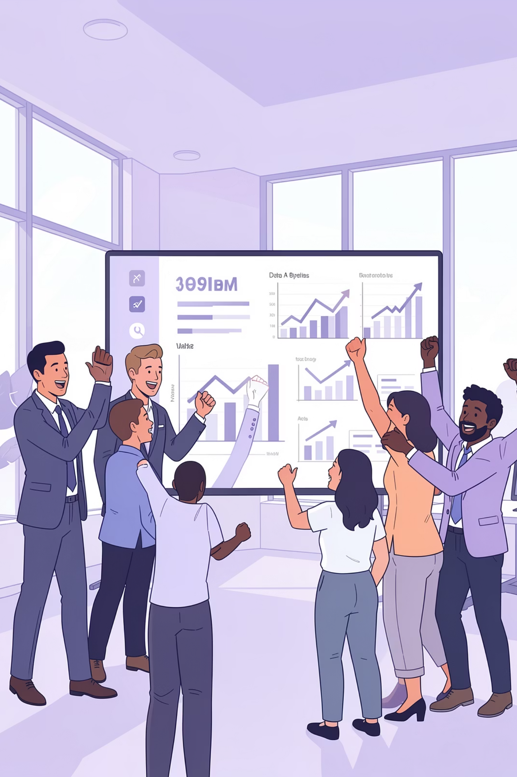
Thank You

